Slide 1
Structure of Unix System

Slide 2
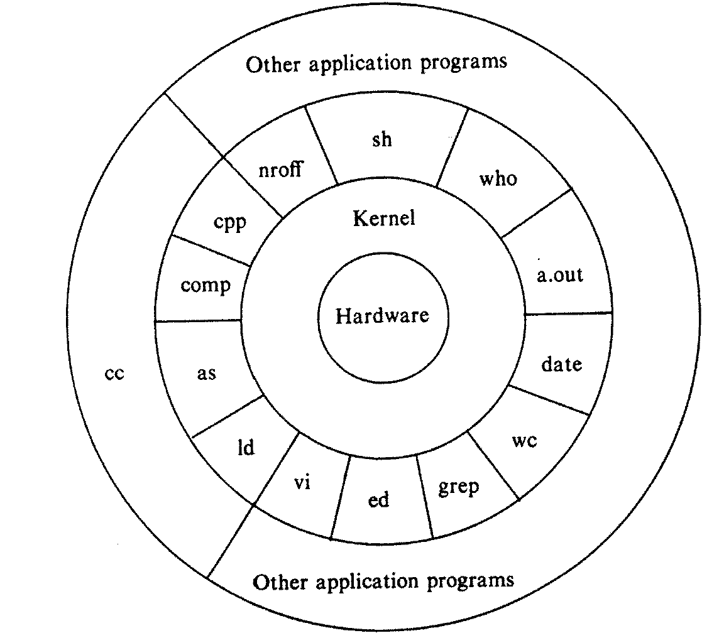
Structure of Unix System
Kernel
Hardware
Shell
Tools & Applications
Architecture of UNIX Systems

Slide 3
Structure of Unix System
HARDWARE
Refers to the physical components that collectively form a computer machine.
Three primary components constitute the hardware of a computer system
I/O devices
Central Processing Unit
Memory

Slide 4
Structure of Unix System
Hardware: I/O devices
Input Devices:
Data is supplied or entered into the computer for processing through input devices such as
Keyboard
Mouse
Trackball
Magnetic ink character recognition (MICR)
Optical character recognition (OCR)
Optical mark recognition (OMR)
Output Devices
Display processed data
Screen
Printer
Two common output devices
Notes:
A trackball is a pointing device consisting of a ball held by a socket containing sensors to detect a rotation of the ball about two axis—like an upside-down mouse with an exposed protruding ball. The user rolls the ball with the thumb, fingers, or the palm of the hand and their nails to move a pointer.
Magnetic ink character recognition code (MICR Code) is a character-recognition technology used mainly by the banking industry to ease the processing and clearance of cheques and other documents.
The MICR encoding, called the MICR line, is at the bottom of cheques and other vouchers and typically includes the document-type indicator, bank code, bank account number, cheque number, cheque amount, and a control indicator.
Optical character recognition (also optical character reader, OCR) is the mechanical or electronic conversion of images of typed, handwritten or printed text into machine-encoded text, whether from a scanned document, a photo of a document, a scene-photo (for example the text on signs and billboards in a landscape photo) or from subtitle text superimposed on an image (for example from a television broadcast).
OMR (optical mark recognition) is a form of automated data input. Marks are made on a specially printed paper forms which are then read by an OMR reader. The data is then sent to a computer for processing. One of the most common uses of OMR is in multiple choice examinations. Students mark their answers on specially printed sheets using either a pencil or a special marker. The sheets are then collected in and the data read using a sheet feed OMR scanner

Slide 5
Structure of Unix System
Hardware: Central Processing Unit
Is the heart of the computer
It obtains
Data from the user through input devices.
Processes the entered data into information
Displays the information through output devices.
Hardware: Memory
It is used for storing data
Memory is of two types
Primary Memory
Secondary Memory
The processed data is
saved in memory for
future use

Slide 6
Structure of Unix System
Primary Memory
RAM (Random Access Memory)
Is the memory or information storage in a computer that is used to store running programs and data for the programs.
Data (information) in the RAM can be read and written quickly in any order.
The contents of RAM are accessible faster than other types of information storage but are lost every time the computer is turned off.
Its Volatile in nature
ROM (Read Only Memory)
Unlike RAM, it keeps its contents even when the computer or device is turned off.
Its Non Volatile in nature, example – boot loader is stored in ROM

Slide 7
Structure of Unix System
Secondary Memory
Secondary memory is external and permanent memory that is useful to store the external storage media.
Floppy Disks
Magnetic disks
Magnetic tapes
Pen Drives
CDs/DVDs and so on
Once data written in them will be stored until deleted by the user.

Slide 8
Structure of Unix System
KERNAL
Is heart of any operating system.
Main purpose is
Ensure that jobs of the operating systems are performed properly.
Jobs mainly include
Scheduling of tasks
Resource Management
Allotment of CPU time, Disk space, Memory Space and so on
Process Management
Allocation of resources such as CPU, Memory and other devices
File Management
Management of files and
Their permission among others
Notes:
Schedule Tasks on Linux Using Crontab
http://kvz.io/blog/2007/07/29/schedule-tasks-on-linux-using-crontab/

Slide 9
Structure of Unix System
The operation performed by the Kernel
It controls the execution of processes by enabling their
Creation
Termination or suspension and
Communication
It schedules process fairly for execution on the CPU
The process share the CPU in a time – shared manner.
It allocates
Main memory for an executing process.
Secondary memory for efficient storage and retrieval of user data.

Slide 10
Structure of Unix System
It allows
Processes controlled access to peripheral devices such as
Terminals
Tape drives
Disk drives and
Network devices
It provides the necessary functionality to
Applications
Shells
Utilities
Through system call interface
Notes:
In computing, a system call is the programmatic way in which a computer program requests a service from the kernel of the operating system it is executed on. This may include hardware-related services (for example, accessing a hard disk drive), creation and execution of new processes, and communication with integral kernel services such as process scheduling. System calls provide an essential interface between a process and the operating system.

Slide 11
Structure of Unix System
Figure: Different tasks performed by the Kernel
Applications
Shells
Utilities
System Call Interface
Kernel
Memory Management
Process Scheduling
File Systems
Peripheral Devices
. . . . . . ….

Slide 12
Structure of Unix System
SHELL
Is an interface between
The user and
The kernel
Kernel does not know human language, hence
The shell accepts the commands from the user and converts them into a language that the kernel can understand.
Is a program that
Interprets user requests
Calls programs from the memory and
Execute them one at a time.

Slide 13
Structure of Unix System
Several shells are available
Bourne shell
Korn shell
Bourne-again shell &
C shell
Shells are independent of the underlying Unix kernel.
This fact has enabled the development of several shells for Unix systems.

Slide 14
Structure of Unix System
Each shell has its own special feature
Bourne Shell
This is most common shell in Unix system & was the first major shell.
Developed by Steve Bourne at AT&T labs.
Released in 1977 & was call ‘sh’
Korn Shell
Developed by David Korn at AT& T Bell labs.
Its built on Bourne shell.
Most stable version of this shell was released in 1988 by AT&T’s Unix System Laboratories as ‘ksh’.
Korn shell also incorporates the features of the C shell.
Important feature
It can run Bourne shell script without any modification at all.

Slide 15
Structure of Unix System
Bourne-again shell
Also known as ‘bash’.
Is distributed as the standard shell in almost all Unix systems.
It’s a freeware shell from the Free Software Foundation (FSF)
Developed by
Brain Fox & Chet Raney.
C Shell
Is also call the programmer’s shell.
‘csh’
Developed by
Bill Joy at the University of California, Berkely.
This shell go this name because
Its syntax and usage is very similar to the C programming language.
A compatible version of the C shell ‘tcsh’ is used in Linux.
It is not always available on all machines.
Shell script in this is not compatible with the Bourne shell.

Slide 16
Structure of Unix System
TOOLS & APPLICATIONS
These are built in modules that are used by the operating system to perform the tasks assigned by the user.
Are available in the form of libraries that add special capabilities to the operating system.
There are various commands and utilities which you would used in day today life.
Ex. cp, mv, grep …..
There are over 250 standard commands and numerous other commands provided through third party software

Slide 17
Unix Environment

Slide 18
Unix Environment
Unix is a multi user & multi processing operating system that can be used in three environments
Stand – alone personal environment
Time – sharing environment
Client server environment

Slide 19
Unix Environment
Stand – alone personal environment
Unix can be installed on personal computes and used as stand alone machine
Major features of the Unix operating system
Multi – user environment
Security features
Multi – tasking capabilities
Portability
Makes an attractive choice for installation on
personal computers

Slide 20
Unix Environment
Time – Sharing Environment
Time – sharing environment is an environment in which a computer is connected to several terminals.
All terminals share the resources of the central computer
i.e., CPU time, hard disk & printer
Central computer divides CPU time into small time slices & serves each terminal in the time slot assigned to it.
Each terminal waits for its time slot to get its job processed by the central computer.
Though this environment is economical, the total dependency on the central computer is its major drawback.
If central computer or machine fails
All terminals connected to it stops working . Hence this environment is not popular now a days.
Since all tasks of the terminal are performed by the central CPU, it is overloaded and hence its response is very poor

Slide 21
Unix Environment
Client – Server Environment
This is better than time – sharing environment
Here the central computer is connected to workstation or PCs that have their individual processing power.
Workstations are known as Clients & Central computers are known as Servers.
Local tasks & small tasks are performed at client level so it decreases the dependency on the central computers.
Servers are not overloaded
In this the response time increases.

Slide 22
Accessing Unix
When you first connect to a UNIX system, you usually see a prompt such as the following
To log in:
Have your userid (user identification) and password ready.
Contact your system administrator if you don't have these yet.
Userid & password are case-sensitive, so be sure you type it exactly as your system administrator instructed.
Once logged in
Read the information messages that come up on the screen something as below.
login:
login: sks sks’s password: Last login: Sun Jun 14 09:32:32 2015 from 62.61.164.73
$

Slide 23
Accessing Unix
For example to check calendar you need to type
cal command
$ cal June 2009
Su Mo Tu We Th Fr Sa
1 2 3 4 5 6
7 8 9 10 11 12 13
15 16 17 18 19 20
21 22 23 24 25 26 27
28 29 30
$
Notes:
You would be provided with a command prompt ( sometime called $ prompt ) where you would type your all the commands.

Slide 24
Accessing Unix
Change Password
The steps to change your password:
To start, type passwd at command prompt.
Enter your old password the one you're currently using.
Type in your new password. Always keep your password complex enough so that no body can guess it. But make sure, you remember it.
You would need to verify the password by typing it again
$ passwd
Changing password for sks
(current) Unix password:******
New UNIX password:*******
Retype new UNIX password:*******
passwd: all authentication tokens updated successfully
$
Notes:
All Unix systems require passwords to help ensure that your files and data remain your own and that the system itself is secure from hackers and crackers. Here are the steps to change your password:

Slide 25
Accessing Unix
Listing Directories and Files:
All data in UNIX is organized into files.
All files are organized into directories.
These directories are organized into a tree-like structure called the file system.
You can use ls command to list out all the files or directories available in a directory.

Slide 26
Accessing Unix
Example of using ls command with -l option.
$ ls -l
total 19621
drwxrwxr-x 2 sks sks 4096 Dec 25 09:59 uml
–rw-rw-r-- 1 sks sks 5341 Dec 25 08:38 uml.jpg
drwxr-xr-x 2 sks sks 4096 Feb 15 2006 univ
drwxr-xr-x 2 root root 4096 Dec 9 2007 urlspedia
-rw-r--r-- 1 root root 276480 Dec 9 2007 urlspedia.tar
drwxr-xr-x 8 root root 4096 Nov 25 2007 usr
-rwxr-xr-x 1 root root 3192 Nov 25 2007 webthumb.php
-rw-rw-r-- 1 sks sks 20480 Nov 25 2007 webthumb.tar
-rw-rw-r-- 1 sks sks 5654 Aug 9 2007 yourfile.mid
-rw-rw-r–- 1 sks sks 166255 Aug 9 2007 yourfile.swf
$
Notes:
Here entries starting with d..... represent directories. For example uml, univ and urlspedia are directories and rest of the enteries are files.

Slide 27
Accessing Unix
Who Are You
The easiest way to find out "who you are" is to enter the whoami command:
Who is Logged In?
Sometime you might be interested to know who is logged in to the computer at the same time.
There are three commands are available
users, who, and w.
$ whoami
sks
$
$ who
sks ttyp0 Oct 8 14:10 (limbo) abc ttyp2 Oct 4 09:08 (calliope) pqr ttyp4 Oct 8 12:09 (dent)
$
$ users
sks abc pqr
Notes:
While you're logged in to the system, you might be willing to know : Who am I?
Try w command on your system to check the output. This would list down few more information associated with the users logged in the system

Slide 28
Accessing Unix
Logging Out
To log out:
Just type logout command at command prompt, and the system will clean up everything and break the connection.
Notes:
When you finish your session, you need to log out of the system to ensure that nobody else accesses your files while masquerading as you

Slide 29
Accessing Unix
System Shutdown:
The most consistent way to shut down a Unix system properly via the command line is to use one of the following command
Command | Description
halt | Brings the system down immediately.
init 0 | Powers off the system using predefined scripts to synchronize and clean up the system prior to shutdown
init 6 | Reboots the system by shutting it down completely and then bringing it completely back up
poweroff | Shuts down the system by powering off.
reboot | Reboots the system.
shutdown | Shuts down the system.
Notes:
You typically need to be the superuser or root (the most privileged account on a Unix system) to shut down the system, but on some standalone or personally owned Unix boxes, an administrative user and sometimes regular
users can do so.

Slide 30
Accessing Unix
Hidden Files:
An invisible file is one whose first character is the dot or period character (.).
UNIX programs (including the shell) use most of these files to store configuration information.
Some common examples of hidden files include the files:
.profile: the Bourne shell ( sh) initialization script
.kshrc: the Korn shell ( ksh) initialization script
.cshrc: the C shell ( csh) initialization script
.rhosts: the remote shell configuration file

Slide 31
Accessing Unix
To list invisible files, specify the -a option to ls:
$ls-a
. .profile docs lib test_ results
.. .rhosts hosts pub users
.emacs bin hw1 res.01 work
.exrc ch07 hw2 res.02
.kshrc ch07 .bak hw3 res.03
Notes:
We will see more of this in next class.

